Slide 1
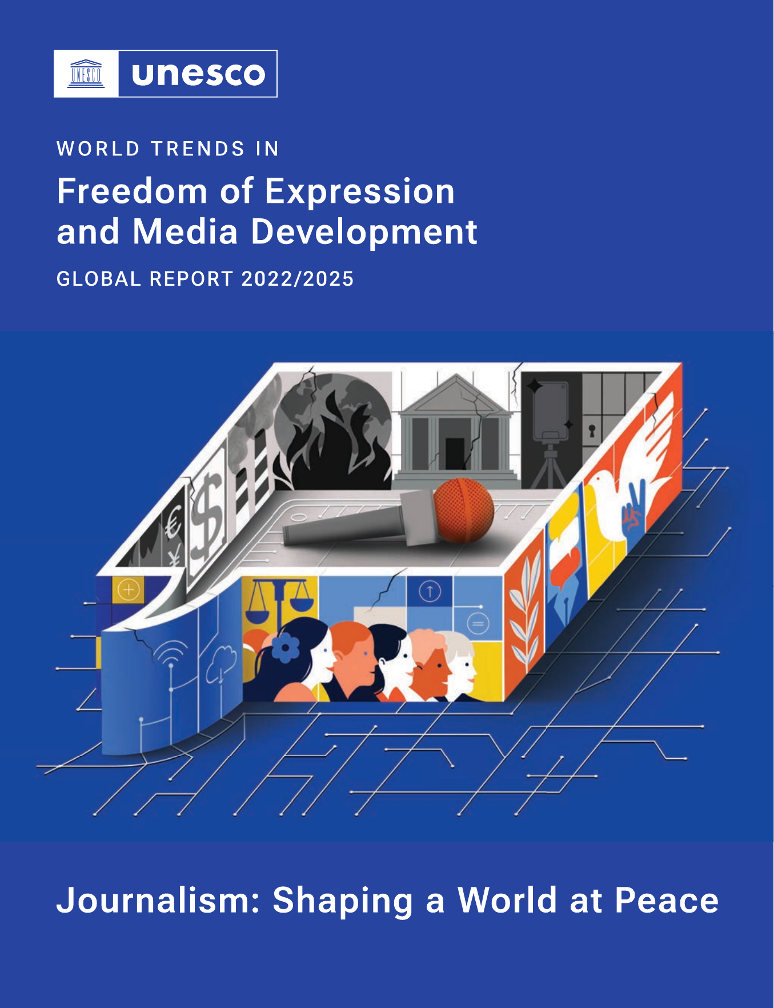
JOURNALISM ETHICS FORUM 2026
UNESCO’s work on AI
and journalism ethics
A human-rights compass for newsrooms
in the age of generative AI
Xuebing SHI
Programme Assistant • UNESCO Regional Office for East Asia
17 September 2026 • Ulaanbaatar, Mongolia

Slide 2
UNESCO • AI AND JOURNALISM ETHICS
World Trends 2022–2025: the technology chapter
WHY THIS REPORT LEADS THE PRESENTATION
The report examines freedom of expression through information as a public good and information integrity.
Chapter 2 applies those lenses directly to journalism and emerging technology.
01
Editorial practice
AI can strengthen research and investigation, but every output still requires evidence, verification and human responsibility.
02
Information integrity
Synthetic media, automated low-value content and over-reliance can make authoritative reporting harder to identify.
03
Pluralism and viability
Language bias, platform power and changing traffic and compensation flows can place local and independent media at a disadvantage.
This is the central UNESCO frame for the slides that follow.
UNESCO
02

Slide 3
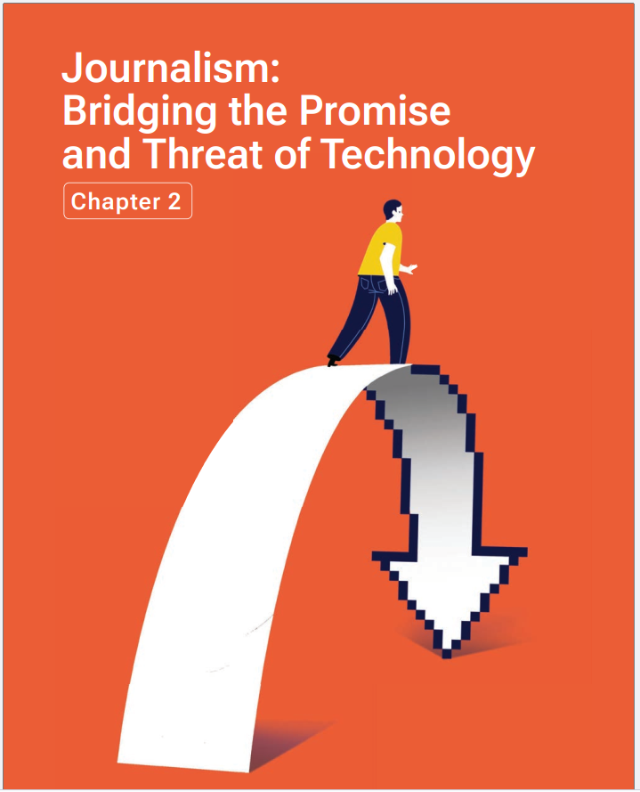
UNESCO • AI AND JOURNALISM ETHICS
A key UNESCO reference for journalism in the AI era
WORLD TRENDS REPORT 2022–2025
Journalism: Bridging the Promise
and Threat of Technology
Chapter 2, beginning on page 71 of the publication
01
Promise
AI can uncover patterns in large datasets, historical records, satellite imagery and other evidence.
02
Threat
Synthetic content, AI over-reliance and embedded bias can weaken information integrity and pluralism.
03
Structural issue
AI systems reshape discovery, traffic and value flows, placing smaller and local-language media at greater risk.
The chapter treats AI as an editorial, governance and media-viability issue.
UNESCO
03

Slide 4
UNESCO • AI AND JOURNALISM ETHICS
The chapter’s message for newsrooms
01
Use AI where it adds evidence
The report highlights pattern finding, archival research and analysis of large or difficult datasets.
02
Expect manipulation at scale
Generative systems can create convincing synthetic material and flood the information space with low-value content.
03
Protect linguistic diversity
Training data dominated by English and the Global North can marginalize local languages, histories and perspectives.
04
Defend journalism’s value
AI-mediated discovery can reduce referrals and weaken compensation for the reporting that models rely on.
Professional journalism remains essential, but newsrooms cannot solve these structural pressures alone.
UNESCO
04

Slide 5

UNESCO • AI AND JOURNALISM ETHICS
The UNESCO AI Ethics Recommendation as a newsroom test
01
Necessity and harm
Does AI improve the journalism, and what foreseeable harm could follow?
02
Privacy and sources
Will prompts, datasets or vendors expose confidential material?
03
Fairness and pluralism
Whose language, identity or viewpoint is missing or misrepresented?
04
Transparency
What should audiences know about AI’s material role?
05
Human accountability
Who approves publication, responds to harm and corrects the record?
Adopted by UNESCO Member States in 2021
UNESCO
05

Slide 6
UNESCO • AI AND JOURNALISM ETHICS
Ethics across the editorial lifecycle
1
2
3
4
5
6
COMMISSION
GATHER
GENERATE
VERIFY
PUBLISH
CORRECT
Purpose, public value and risk
Consent, privacy and source protection
Provenance, copyright and bias
Independent evidence and authenticity
Disclosure, approval and accountability
Traceable corrections and lessons
Verification runs through the process, from commissioning to correction.
UNESCO
06

Slide 7
UNESCO • AI AND JOURNALISM ETHICS
Three minimum safeguards for newsroom trust
01
Visible authorship
Do not present AI-generated reporting as if a journalist independently reported it.
02
Independent verification
Check names, quotations, figures, images and claims against reliable evidence.
03
Human editorial accountability
An editor remains responsible for publication, harm assessment and correction.
AI may assist editorial judgment. It does not assume editorial responsibility.
UNESCO
07

Slide 8
UNESCO • AI AND JOURNALISM ETHICS
UNESCO’s journalism response across the information ecosystem
NEWSROOM
Policies for approved uses, verification, disclosure, source protection and correction
PROFESSION
Press councils, journalism education, safety and standards that protect independence
PLATFORMS
Human-rights due diligence, transparency, accountability and access to data
PUBLIC
Media and information literacy that strengthens critical use and public agency
Trust depends on relationships among newsrooms, professional bodies, platforms and audiences.
UNESCO
08

Slide 9
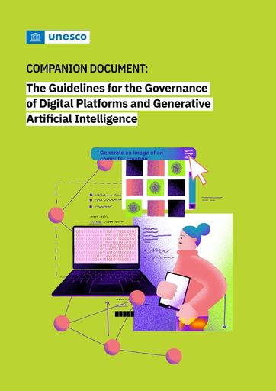
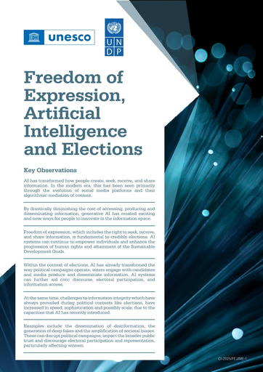
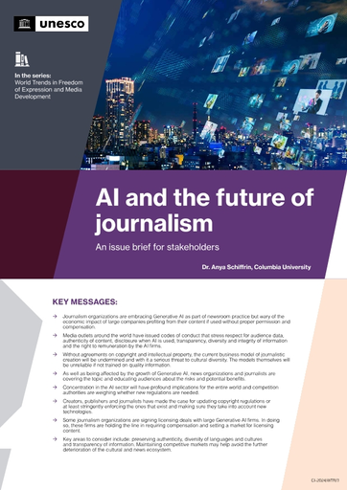
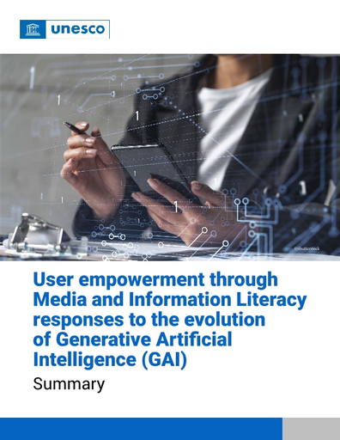

UNESCO • AI AND JOURNALISM ETHICS
Current UNESCO resources on AI, media and journalism
2025
2025
2025
World Trends Report 2022–2025
Digital Platforms and Generative AI
Freedom of Expression, AI and Elections
Core report and technology chapter
Companion document
UNESCO–UNDP issue brief
2024
2024
2023
AI and the Future of Journalism
User Empowerment through MIL and Generative AI
Guidelines for the Governance of Digital Platforms
Issue brief for stakeholders
Policy brief summary
Global governance framework
UNESCO
09

Slide 10
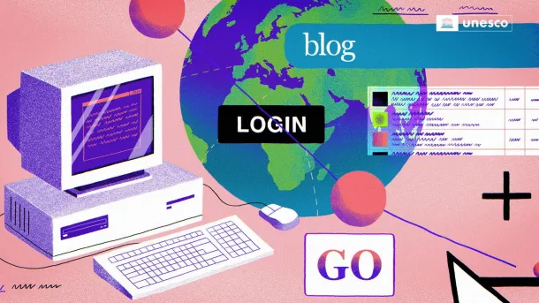
UNESCO • AI AND JOURNALISM ETHICS
Platform governance now includes generative AI
WHAT GOVERNANCE SHOULD SECURE
Rights
Assess impacts on freedom of expression and access to information
Transparency
Explain content systems, policies and material use of generative AI
Accountability
Provide scrutiny, remedy and meaningful stakeholder participation
Media pluralism
Protect independent journalism and avoid discriminatory visibility or access
Newsrooms need the ability to scrutinize the systems that distribute and summarize their work.
UNESCO
10

Slide 11
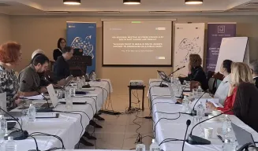
UNESCO • AI AND JOURNALISM ETHICS
Regional Declaration on the Ethical and Transparent Use of AI in the Media
Adopted by press and media councils from South-East Europe and Türkiye
4th regional meeting • Ohrid, North Macedonia • 19–20 May 2025
•
AI should support journalists and newsrooms, not replace professional judgment
•
News organizations retain full editorial accountability
•
Generative AI content requires transparency and labelling
Source: UNESCO • Regional Declaration on the Ethical and Transparent Use of Artificial Intelligence in the Media
4th Regional Meeting • Ohrid, North Macedonia • 19–20 May 2025
•
Risk assessment should address elections, health crises, bias and pluralism
•
Professionals and the public need stronger AI literacy
UNESCO supported the regional process under its EU-funded Building Trust in Media project.
UNESCO
11

Slide 12
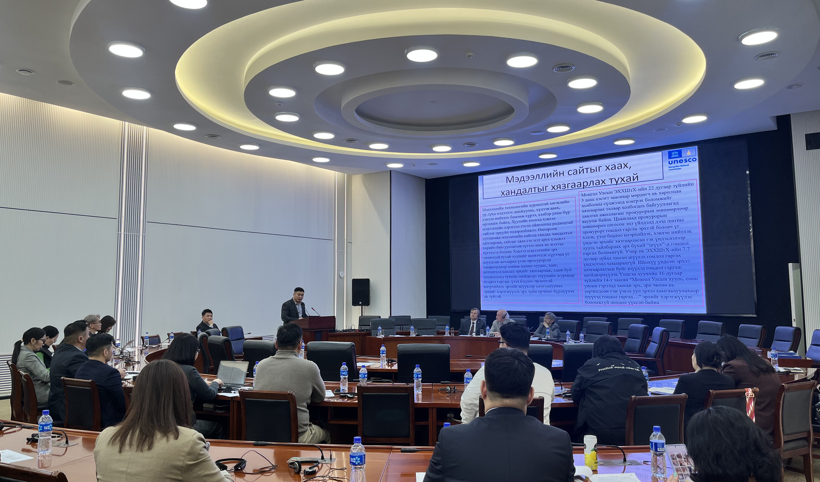

UNESCO • AI AND JOURNALISM ETHICS
Mongolia’s foundations for responsible AI in media
ENABLING ENVIRONMENT
SKILLS AND VERIFICATION
Technical assistance and multistakeholder consultation on the draft Media Freedom Law, plus dialogue on press freedom, safety and access to information.
National forums, training for more than 100 media professionals, the MIL Journalists’ Club, online modules and video lessons.
UNESCO
12

Slide 13
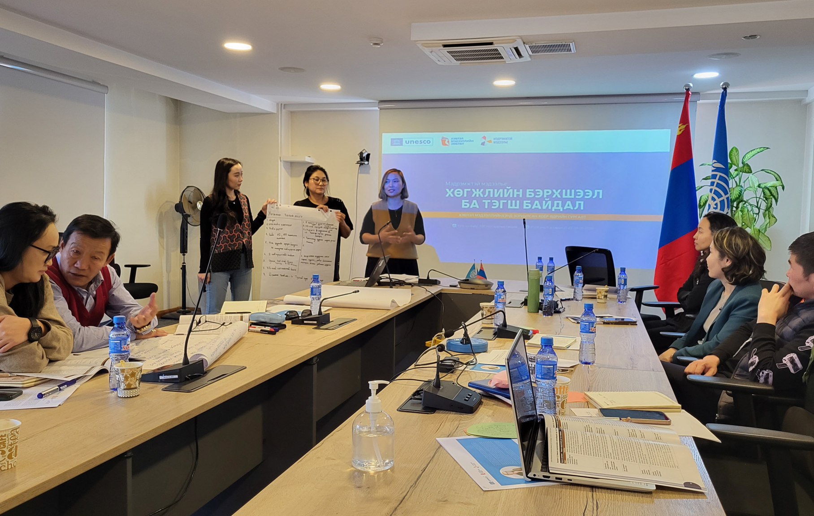
UNESCO • AI AND JOURNALISM ETHICS
Journalism programmes apply AI ethics to real reporting
Inclusive reporting
Disability-inclusive language, accessibility and representation grounded in human rights
Gender-sensitive practice
Standards that reduce stereotypes and improve representation
Climate and heritage
Verification, open-source research and transparent AI use for COP17 coverage
Professional learning
Fact-checking and ethical reflection linked to real editorial decisions
The strongest AI policy connects to everyday reporting, not only to technology teams.
UNESCO
13

Slide 14
UNESCO • AI AND JOURNALISM ETHICS
Practical next steps for Mongolia
01
A newsroom AI policy
Define approved and prohibited uses, source-data rules, human approval, disclosure and correction.
02
A shared verification protocol
Set procedures for synthetic media, quotations, statistics, provenance and election-related content.
03
Capacity in Mongolian contexts
Test tools in Mongolian, document bias and errors, and include regional and minority-language perspectives.
04
Professional self-regulation
Use MCM’s forthcoming AI Code to convene newsroom discussion, gather feedback and update guidance as practice evolves.
UNESCO can contribute human-rights principles, international experience and practical resources.
UNESCO
14

Slide 15

UNESCO • AI AND JOURNALISM ETHICS
The goal is trustworthy journalism
AI can strengthen reporting when journalists retain evidence, judgment and accountability.
Human rights • editorial responsibility • public trust
UNESCO looks forward to continuing this work with MCM and all partners.
15

